Slide 1

Stage 7 Fung Lam Court Course Designer: Arthur Wang
Fung Lam Court is a 25 round, 125 point, COMSTOCK Long course. There are 12 USPSA targets and 1 steel target. The best 2 hits per cardboard target will score. Steel must fall to score.
The start position is standing outside of the shooting area with feet touching the starting stick with wrists below belt. Handgun is loaded and holstered. PCC start position is standing outside of the shooting area with feet touching the starting stick, stock on belt, safety on.
On the audible start signal, engage all targets from within the shooting area. Steel target P1 activates S1, which remains visible at rest.

Slide 2
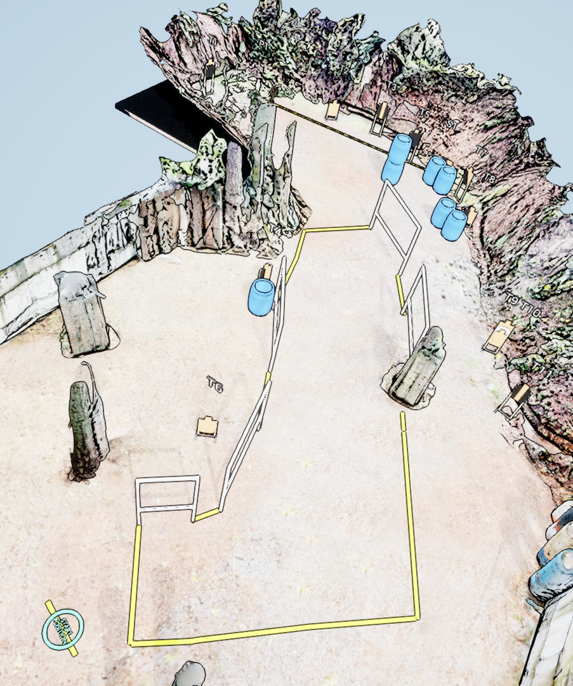
 | Stage 7 Fung Lam Court Course Designer: Arthur Wang

